Slide 1

DSCI-633 FINAL PROJECT PRESENTATION
ADITYA THAKUR

Slide 2
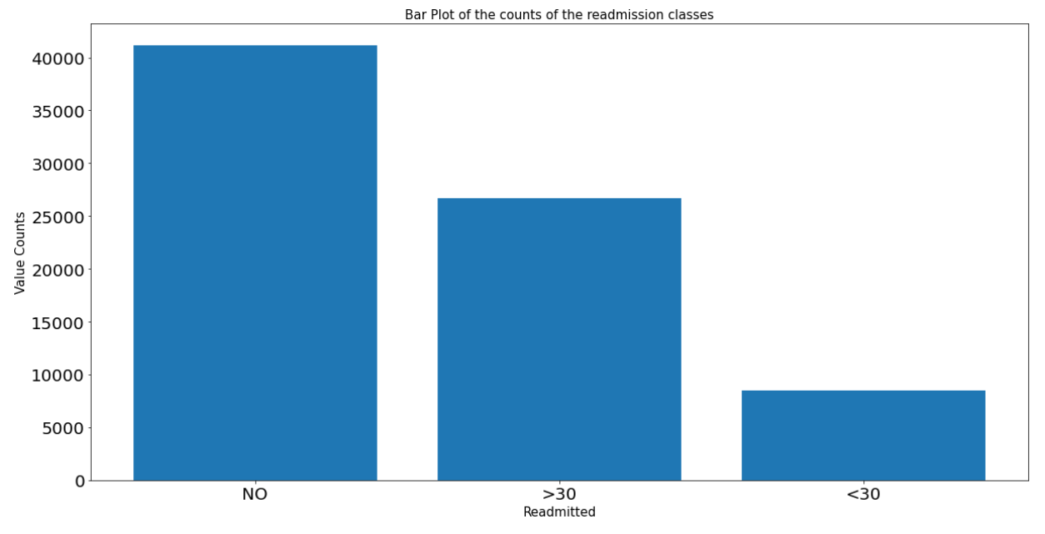
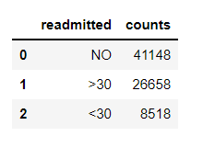
EXPLORATORY DATA ANALYSIS AND PREPROCESSING
Importing the training and test dataset.
Summary Statistics: No unusual jumps in the training data.
The distribution of the classes: There is a class imbalance. The positive class is rare.

Slide 3
EXPLORATORY DATA ANALYSIS AND PREPROCESSING (CONTD)
Encoding the target variable : readmission < 30 = 1 (Positive class) , readmission > 30 / No readmission = 0 (Negative class)
Dropping the features: (i) weight: According to research article, this column contains a huge number of missing values.
(ii) patient_nbr, encounter_id: can wreak havoc with distance computation.
Handling null values: (i) weight: we have already dropped this column.
(ii) race, payer_code and diag_3: Replaced with the mode in the training set.
(iii) medical_specialty: Huge number of missing values but intuitively seem legitimate.
Possible medical procedure not known to us. Replaced nulls with a new value named ‘Unknown’.
Encoding categorical columns: Total 205 features after preprocessing.
Label Encoding: glimepiride-pioglitazone: This column has only one value ‘No’ in the training set,
diag_1,diag_2,diag_3: Huge number of distinct values. One Hot Encoding-> Curse of dimensionality.
(ii) One Hot Encoding: All features except the above four label encoded features.

Slide 4
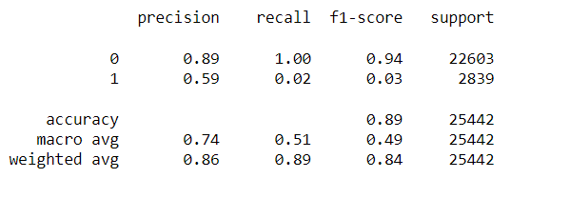
TRAIN TEST SPLIT AND BASELINE MODEL (LOGISTIC REGRESSION)
Since the train-test split is already given, just require to get the feature matrices and target variables from train and test set.
Fitting a Logistic Regression model on the training data and predicting on the test set to get a working model.
The classification report is as below:
From the above report, the accuracy is high (89%). However, the model recall is very low (2% on the positive class). This means that the model is producing a huge number of false negatives(predicting as no readmission or readmission after 30 days when actually readmission should be done within 30 days which can be fatal).

Slide 5
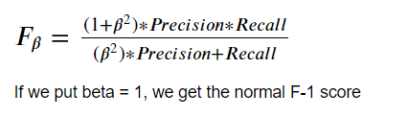
DECIDING THE METRIC OF CHOICE
The accuracy is not a good metric to use in this scenario and we need to focus on recall.
However, since there is a trade-off between precision and recall, if we try to increase recall, the precision of the classifier will go down, which means that we will be incorrectly classifying many samples of the majority class.
The metric F-1 score generally maintains a precision recall trade-off. However, since we want more weight on the recall, we will use a general metric called F-Beta score with beta >1 so that the recall is emphasized more.
We will put 𝛽=5 , so that there is 5X emphasis on recall than on precision while also trying to maintain the trade-off between the two metrics.
This will penalize the model heavily for producing False Negatives and we will use this metric for evaluation and also for hyperparameter tuning

Slide 6
CHALLENGES ENCOUNTERED IN THE PROJECT
(i) Different Values Of Categorical Columns in the training and test set causing issues in One Hot Encoding
Solution: Split the preprocess function into one for training and other for test (which preprocesses the values row by row) and built a custom encoder for the test set which will encode the values using mappings from the training set without actually looking at the test values.
(ii) Visualization of Data since there are large number of features after Categorical variable encoding
Solution: Split the data into two prominent dimensions using PCA
(iii) Maintaining the distribution of classes in the generalization set.
Solution: Using Stratified K-Fold in order to preserve the class distribution in the training and validation set
(iv) Classes are imbalanced and moreover not naturally separable.
Solution: Trying various oversampling and undersampling strategies.

Slide 7
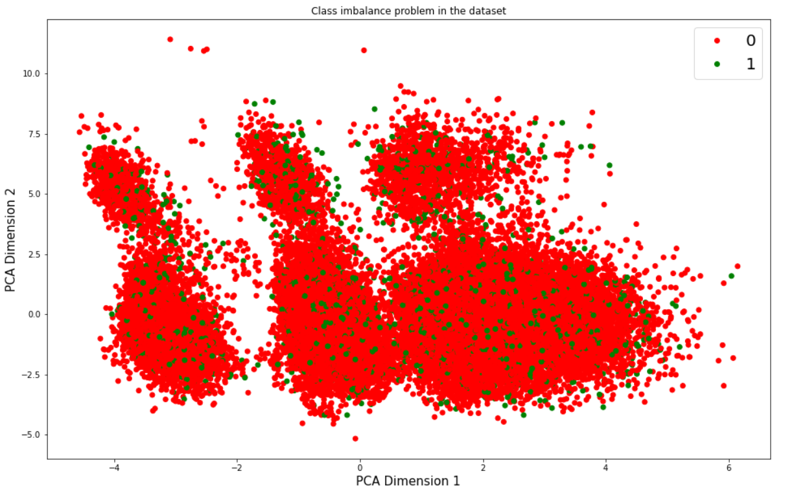
CHALLENGES ENCOUNTERED IN THE PROJECT (CONTD)

Slide 8
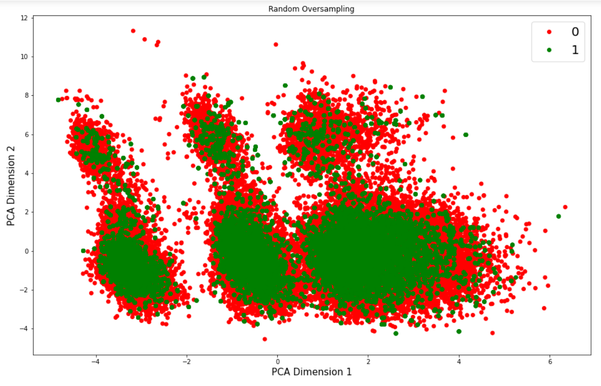
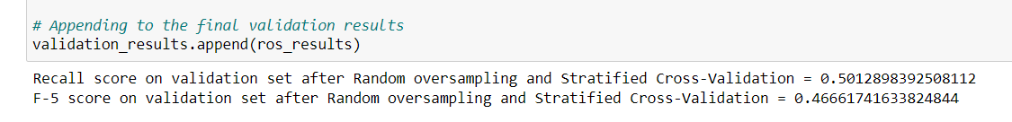
OVERSAMPLING TECHNIQUES: RANDOM OVERSAMPLING
Randomly select the samples of the minority class and add them to the training set with replacement to make the classes balanced.
Fitting logistic regression model on the training set and evaluating on the validation set using Stratified 5-Fold.

Slide 9
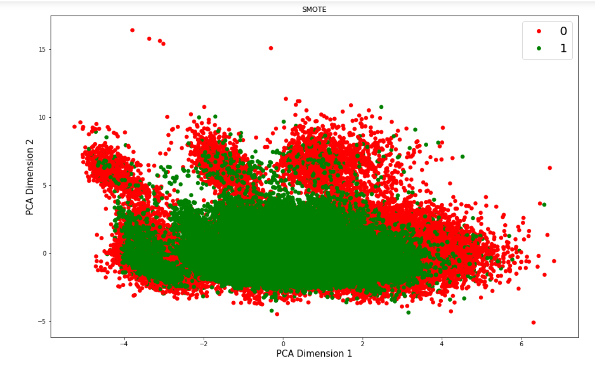
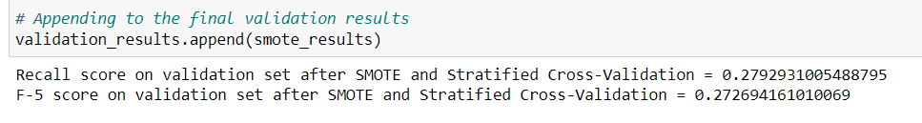
OVERSAMPLING STRATEGIES: SMOTE
Creates minority samples along the line segment joining two nearest minority samples.
Fitting logistic regression model on the training set and evaluating on the validation set using Stratified 5-Fold.

Slide 10
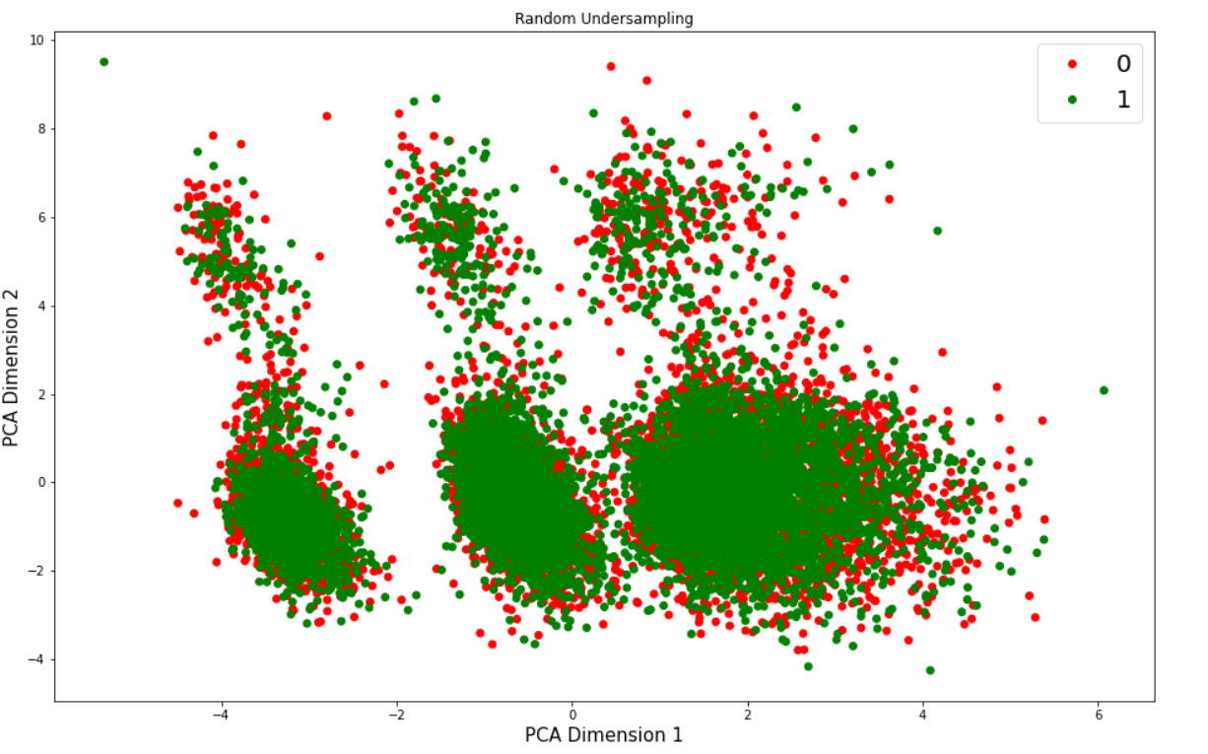
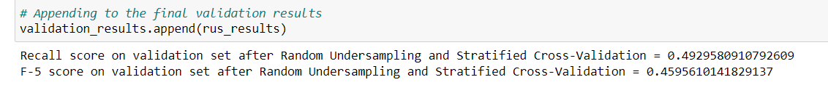
UNDERSAMPLING STRATEGIES: RANDOM UNDERSAMPLING
Randomly delete the samples of the majority class from the training set to make the classes balanced.
Fitting logistic regression model on the training set and evaluating on the validation set using Stratified 5-Fold.

Slide 11
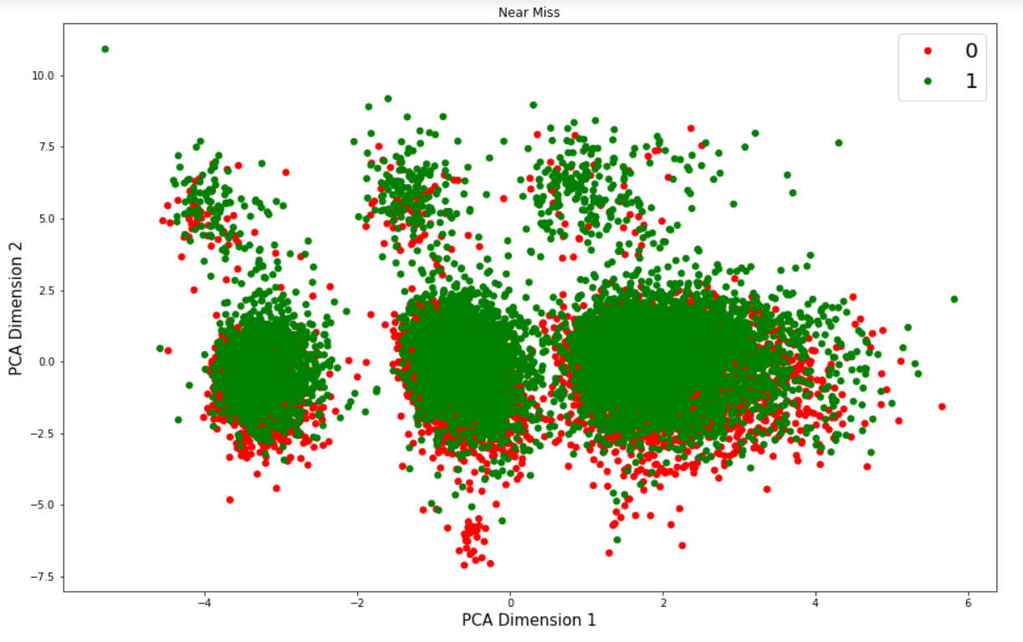
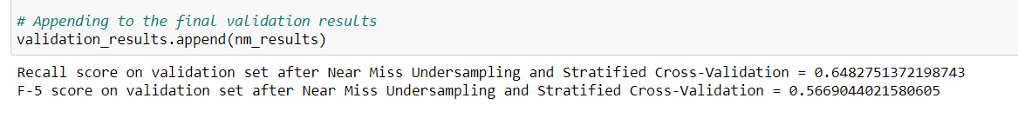
UNDERSAMPLING STRATEGIES: NEAR MISS
Discards the majority class samples that are nearest neighbors of minority class samples.
Fitting logistic regression model on the training set and evaluating on the validation set using Stratified 5-Fold.

Slide 12
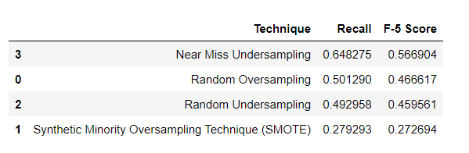
COMPARING VALIDATION RESULTS
The optimized model from the above results seems to be Logistic Regression with Near Miss Undersampling which has an F-5 score of 0.566
However, since we are using Logistic Regression which gives a probability model associated with the predictions, we can threshold our classifier to a minimum limit that gives us a slightly better F-5 score.

Slide 13
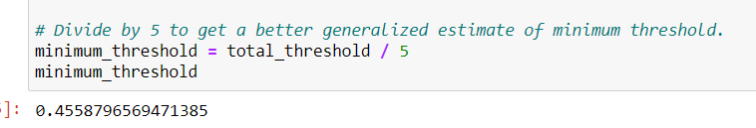
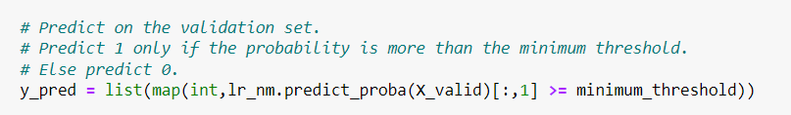
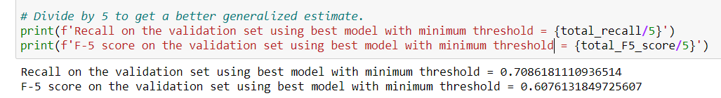
HYPERPARAMETER TUNING / SETTING MINIMUM THRESHOLD
Considered each score returned by the classifier as a threshold value. Predicted positive label above this threshold value and negative label below this threshold value.
Calculated the precision, recall and F-5 score for each threshold value. Selected the optimal threshold value which yielded an F-5 score > 60%.
Got a threshold value of 0.455
Evaluated the optimized model on validation set and predictions done using minimum threshold found

Slide 14
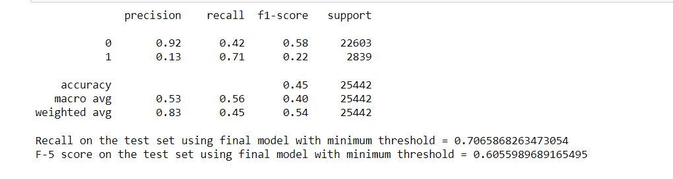
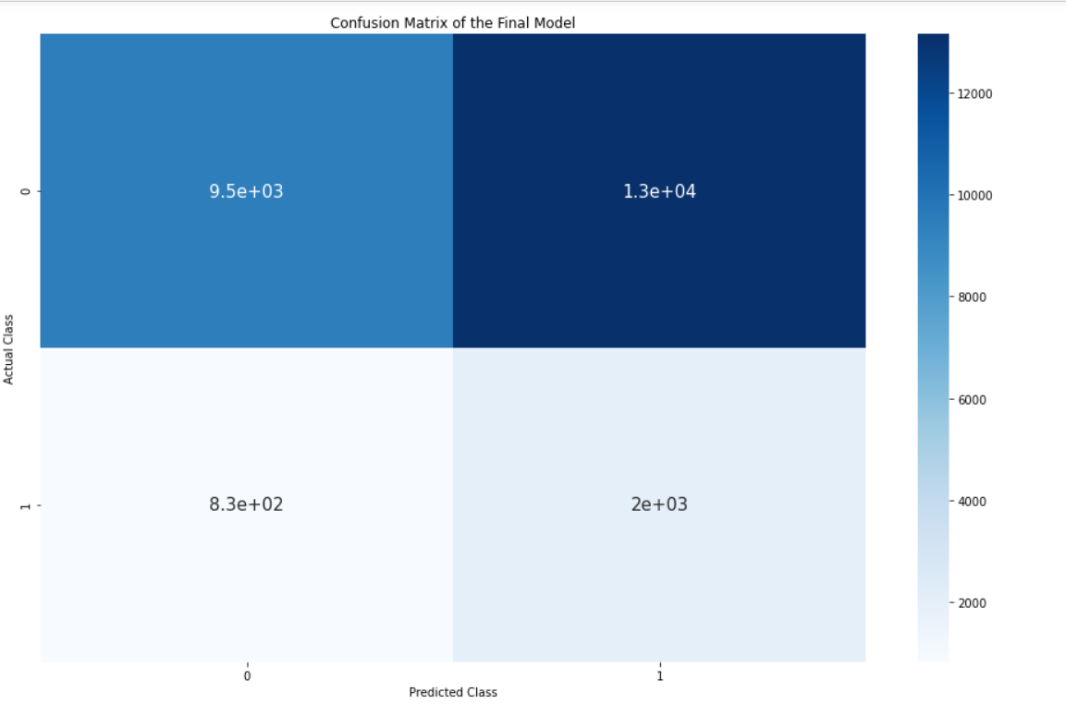
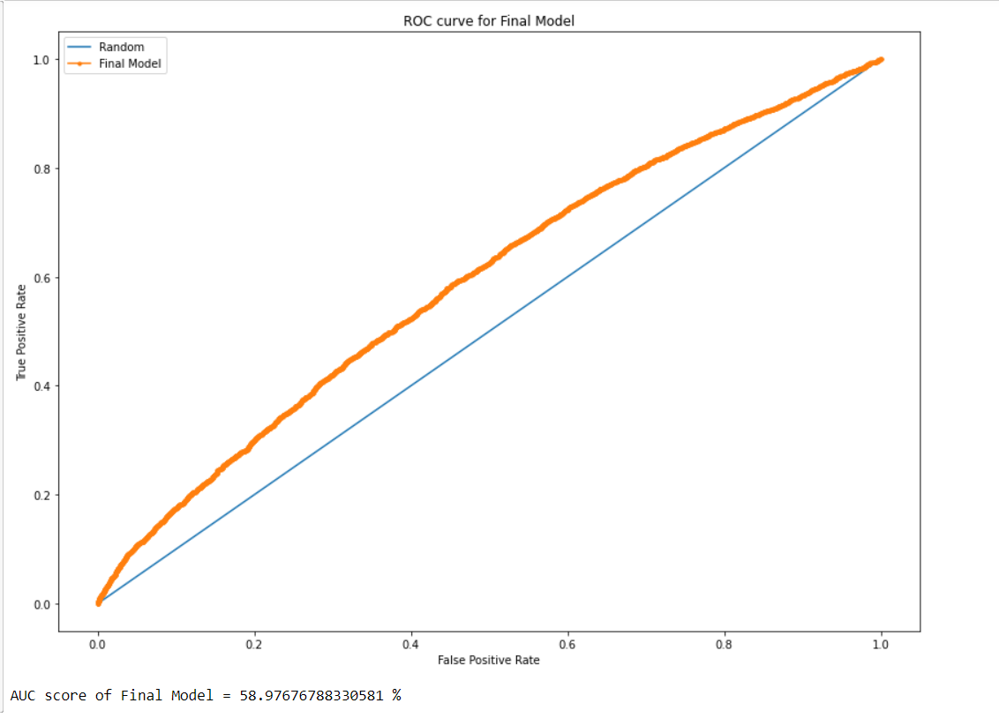
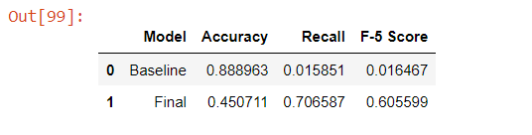
EVALUATING FINAL MODEL ON TEST SET

Slide 15
CONCLUSION
Model Achievements:
- The model generalized very well on unseen data.
Better Performance than a random classifier despite the imbalance and naturally inseparable classes.
An F-5 score of around 60% which is a good improvement over the baseline model.
Model Shortcomings:
Due to the high skew in the dataset, the accuracy /precision value falls when we try to increase the recall.
Scope for future improvement:
- Can try to use neural networks for modelling arbitrary non-linear boundaries as they have the capability to perform feature extraction.

